Slide 1


Project 3:
Distinguishing r/Politics and r/WorldNews by Comments
By Connor Finnerty

Slide 2

Reddit background info
Reddit was created in 2005 by Steve Huffman and Alexis Ohanian with support from Y-Combinator (Peter Thiel’s incubator)
18th most viewed website in the world
  Politics: 8,546,400 subscribers
  WorldNews: 38,205,668 subscribers
Reddit became public in March 2024
  IPO on March 21st
Pictured (from left-right): Reddit founders Alexis Ohanian, Aaron Swartz, Steve Huffman (2005)

Slide 3
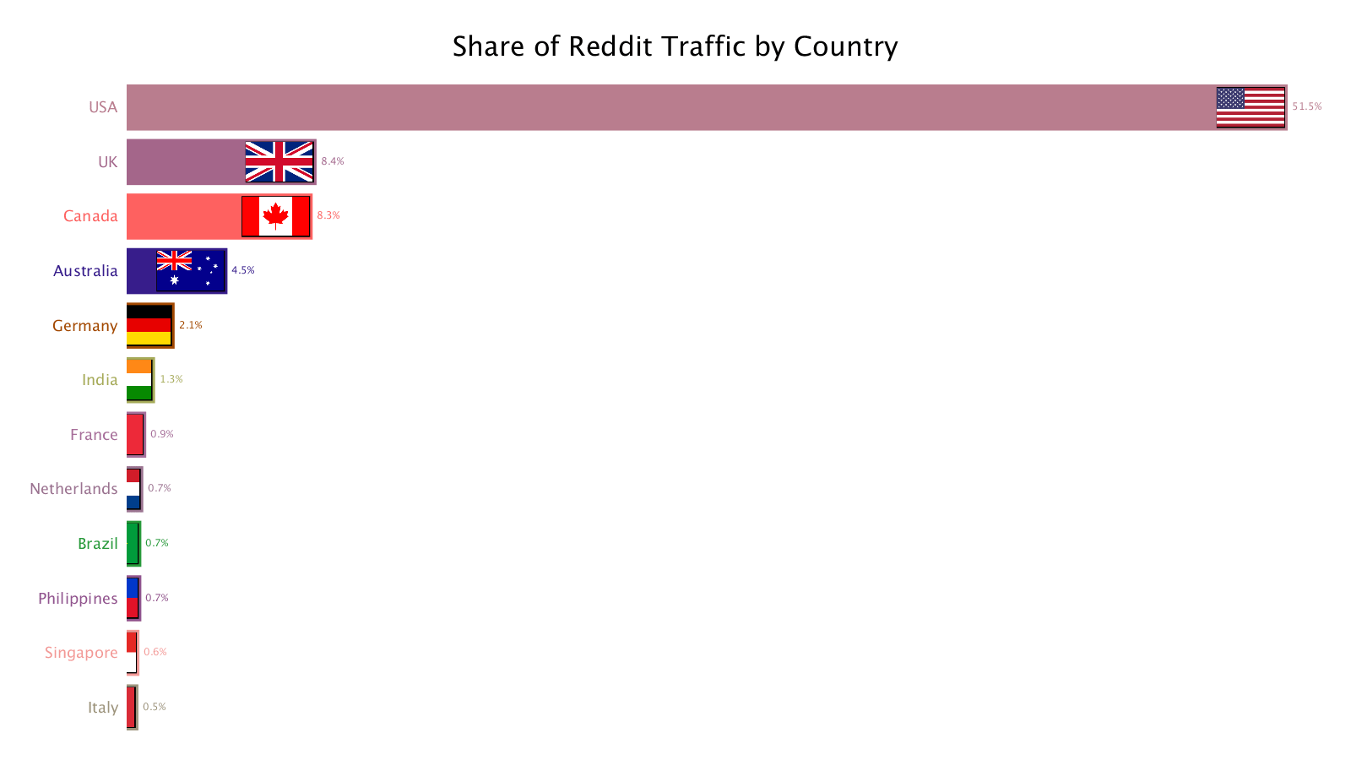
Reddit users are mostly American

Slide 4
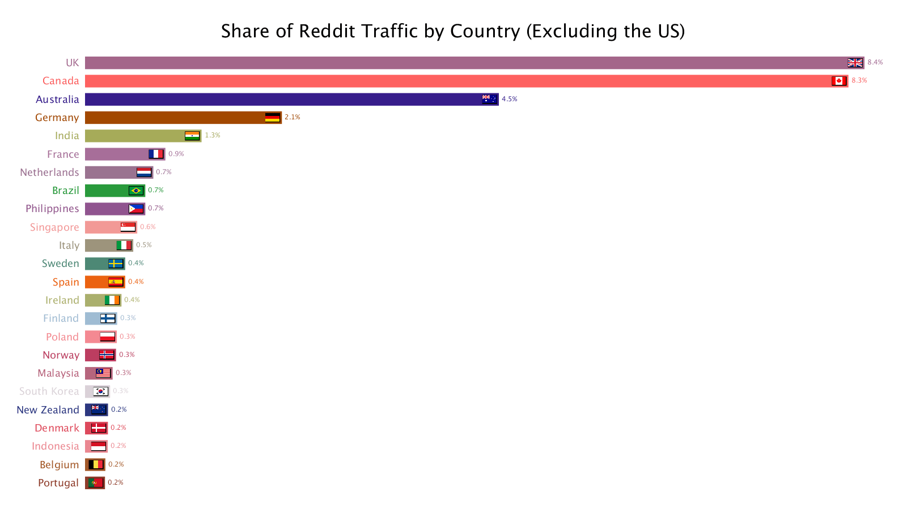
Foreign Reddit Users by Country of Origin
The 3 largest userbases come from anglosphere (English-speaking countries)
The non-anglosphere countries have a high-number of English speakers, either by:
  Percentage (Germany, France, Netherlands, Singapore, Phillippines)
  or Absolute Number (India, Brazil)

Slide 5
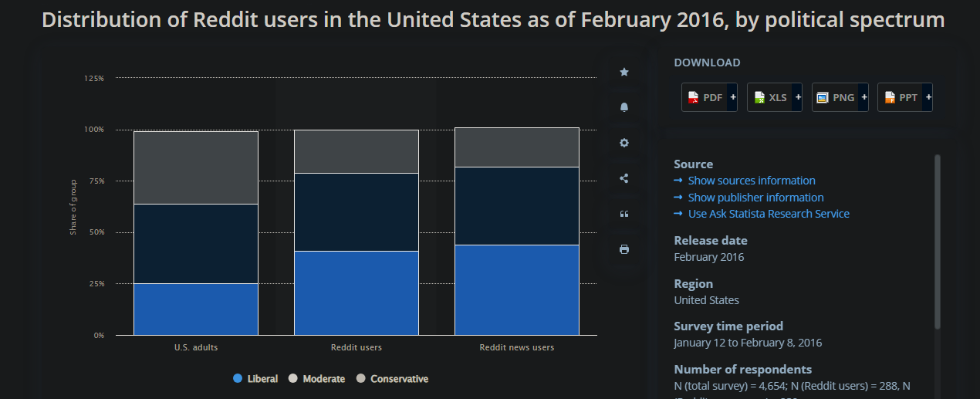
Details on Reddit user political views
As of 2023, only 19% of Reddit Users identify as right-wing/conservative (Marjanovic, 2022)

Slide 6
Why distinguish?
Major issue in modern politics: hobbyism
  Users treat politics as spectator sport
  Focus on stories that satisfy narrative and provide emotional gratification
  Reject the messiness and tediousness of actual political engagement
US users fail to understand major historical and cultural issues of foreign democracies
  Projection (Economic: left vs right; Social: liberal vs conservative)
If a model can be used to classify Politics vs WorldNews commenters, this can help filter out US political hobbyists from r/WorldNews discourse

Slide 7


Prediction:
There is a large enough non-American userbase to distinguish between Subreddits used at differential rates by US and non-US Reddit users
The difference in English words used by Americans vs non-Americans will cause a TDF-IF approach to work best
Raw sentiment analysis will do little to distinguish between WorldNews and Politics (because politics makes everyone mad)

Slide 8
PRAW Process
Created function to extract comments from a given post
Comments for each post and their corresponding scores were matched to each corresponding post

Slide 9
Data Cleaning
Read in each comment from the comments column for each post
Removed non-alpha-numeric characters comments to prepare them for sentiment analysis
Created a dataframe of comments with their corresponding upvote score (so lower upvoted comments could be discounted)
Created an Excel sheet for each comment section for each post, and saved the Excel sheets for the entire scrape as an Excel file
Combined all posts from each Excel file and saved that as one large dataframe
  14,430 total comments
  54.2% from r/WorldNews
  45.8% from r/Politics

Slide 10
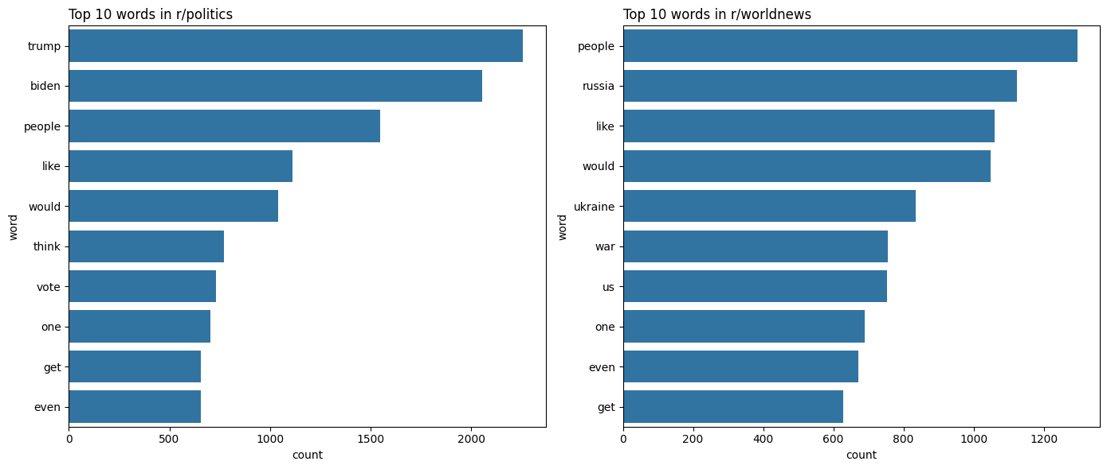
Most common words by Subreddit

Slide 11
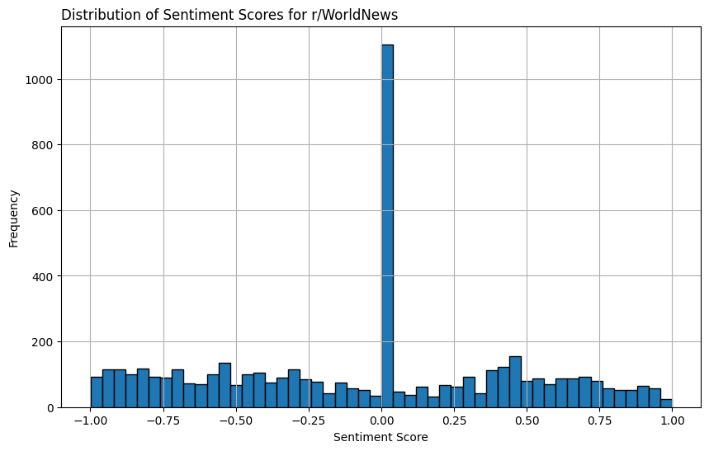
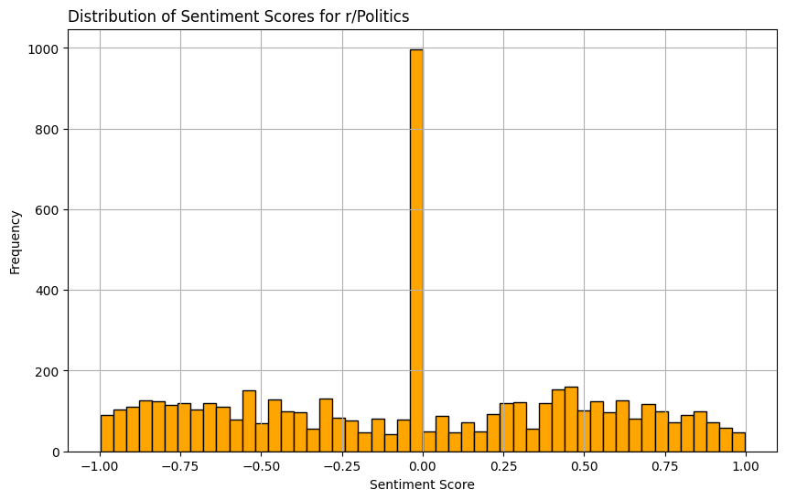
Sentiment Analysis
Sentiment scores for r/Politics and r/WorldNews comments not substantially different
Neg: 0.111966
Neu: 0.786227
Pos: 0.101610
Com: -0.065306
Neg: 0.107468
Neu: 0.788348
Pos: 0.104181
Com: -0.027491
0.101610

Slide 12
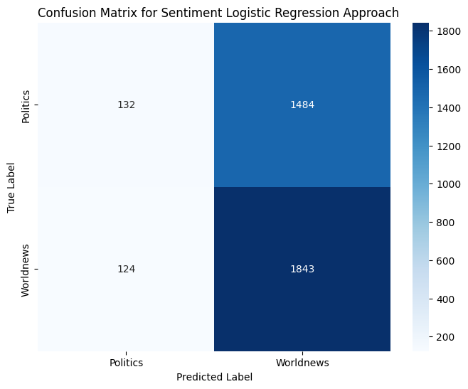
Logistic Regression performed purely on sentiment scores
0.546
Train R²: 0.546
Test R²: 0.551

Slide 13
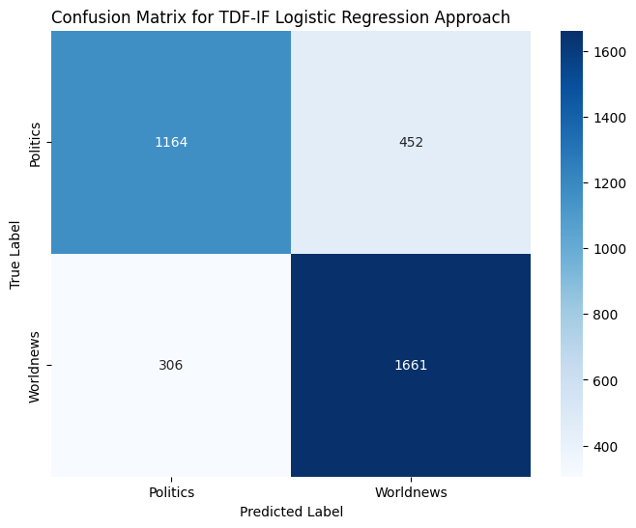
Logistic Regression performed on TDF-IF Vectorized Comments
Train R²: 0.835
Test R²: 0.788

Slide 14

Support Vector Machine performed on TDF-IF Vectorized Comments
Train R²: 0.893
Test R²: 0.786

Slide 15
Conclusions
While possible to outperform baseline, classifying subreddit of origin based on comments is much more difficult than classifying posts the
  language used much more generic and repetitive, less content-laden
Sentiment has little bearing on an attempts to distinguish between news-based subreddits
  People mostly used descriptive terms and evoked concepts, while the emotion was generally negative in both cases
SVM would be a great approach if I had more computing power
  Using GridSearchCV and RandomSearchCV took and incredibly long time

Slide 16
Sources
https://www.statista.com/statistics/517259/reddit-user-distribution-usa-political-spectrum/
https://www.reddit.com/r/dataisbeautiful/comments/phhu9s/oc_reddit_traffic_by_country/
https://www.inc.com/christine-lagorio/reddit-whole-team-here.html
https://pubmed.ncbi.nlm.nih.gov/36288326/

